Slide 1
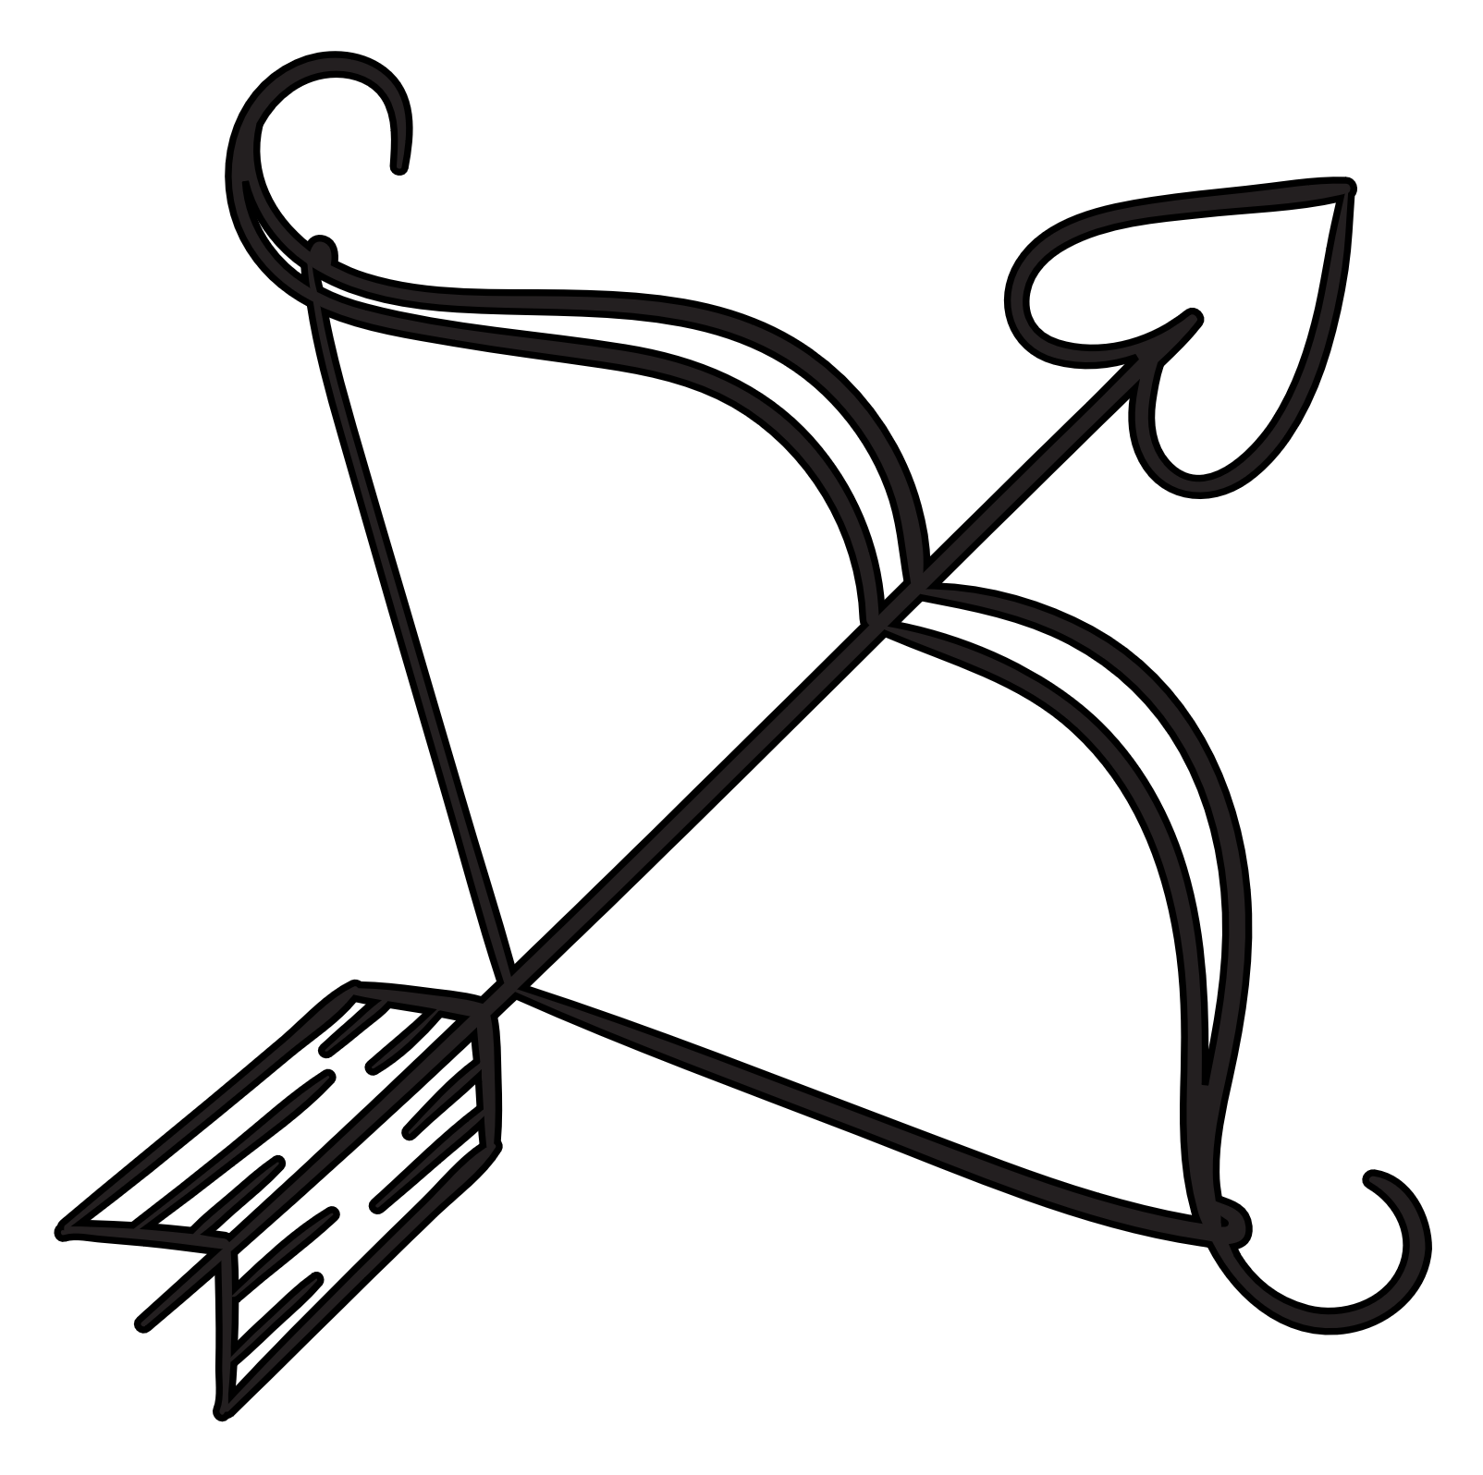
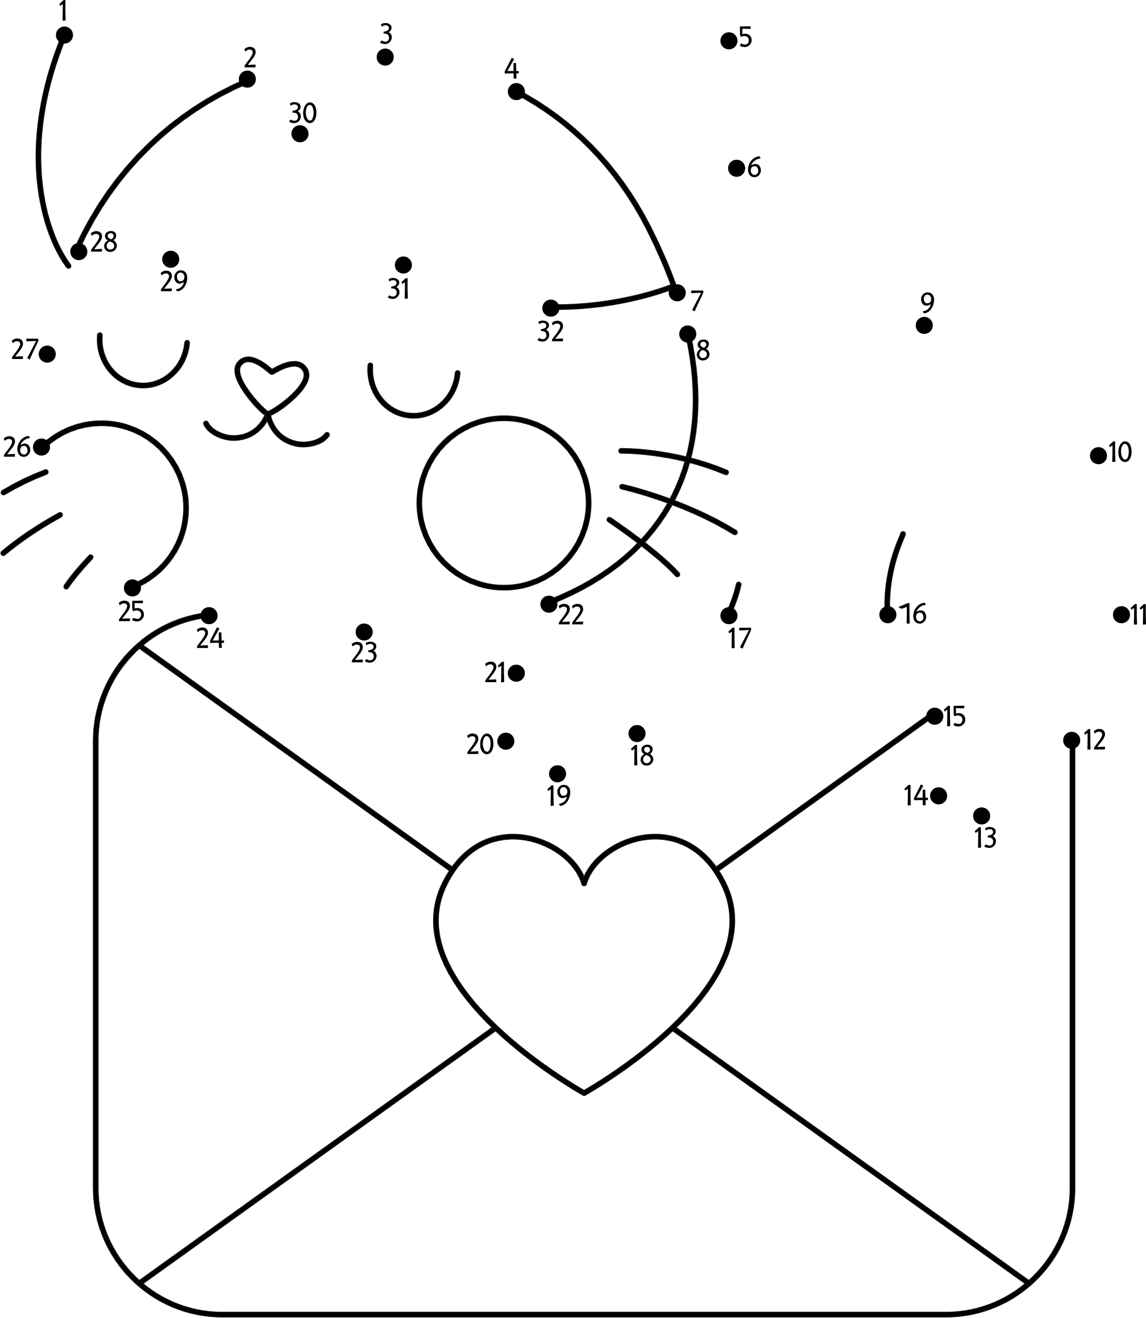
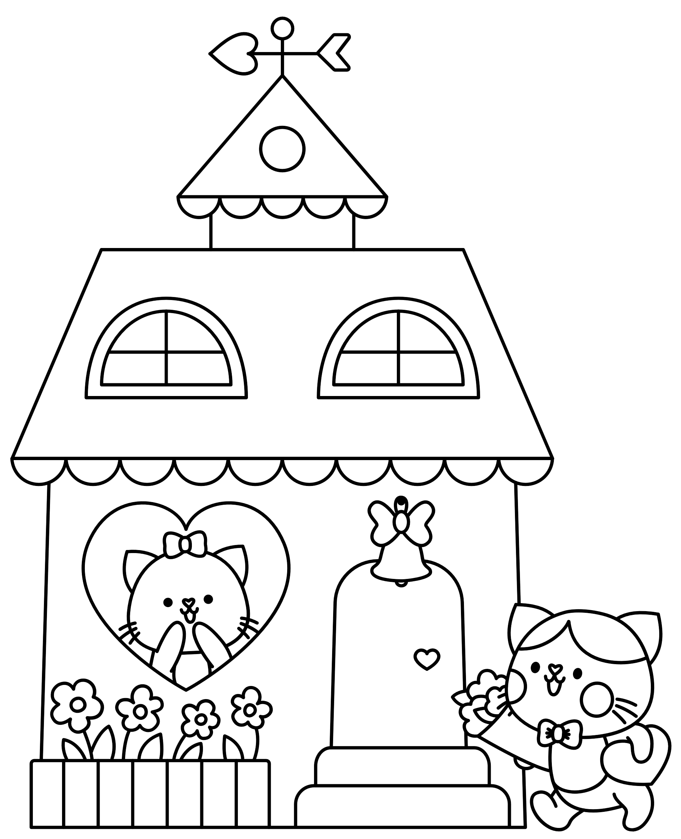
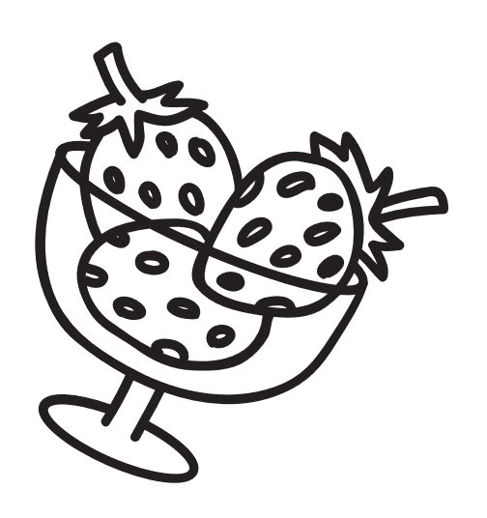
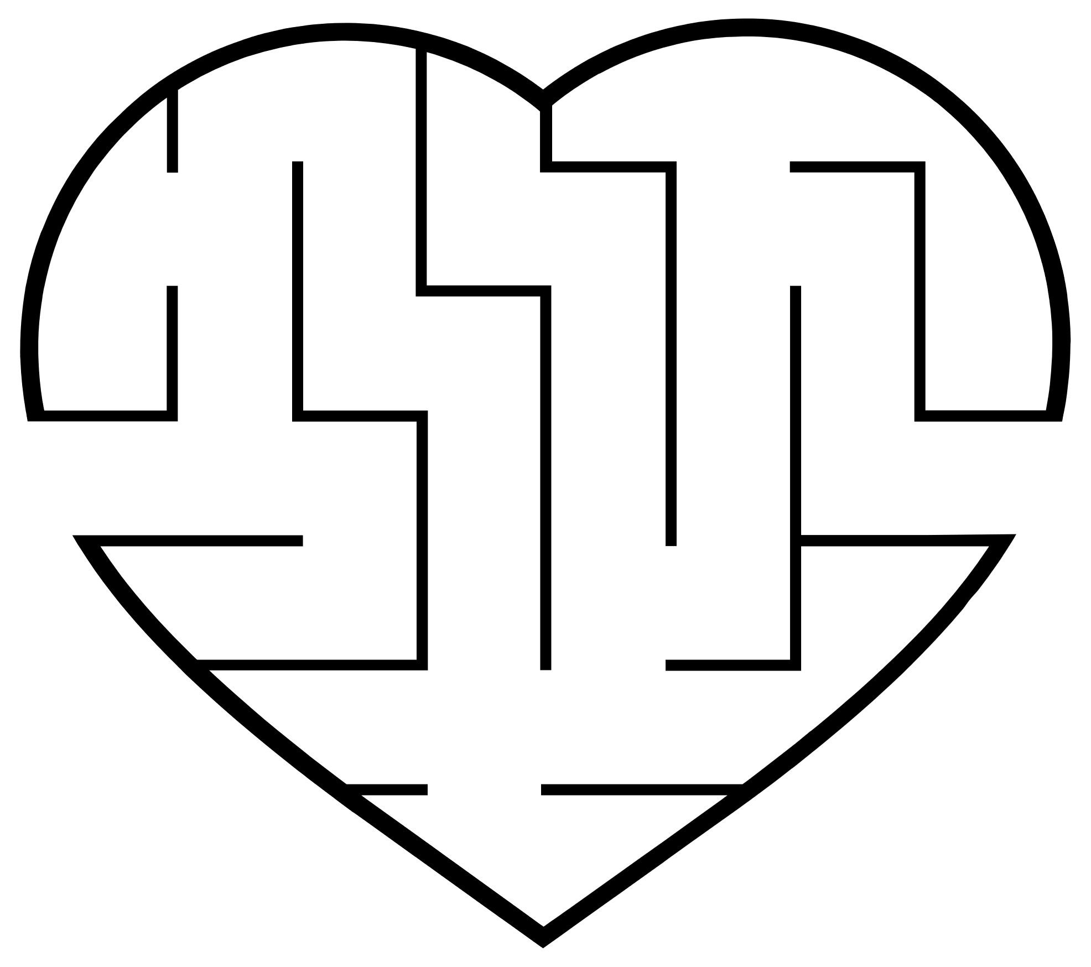
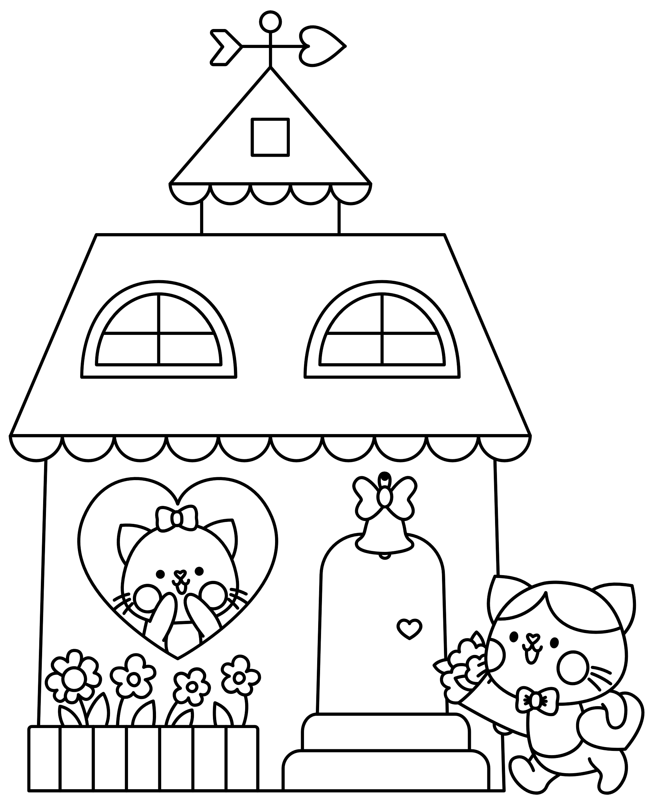
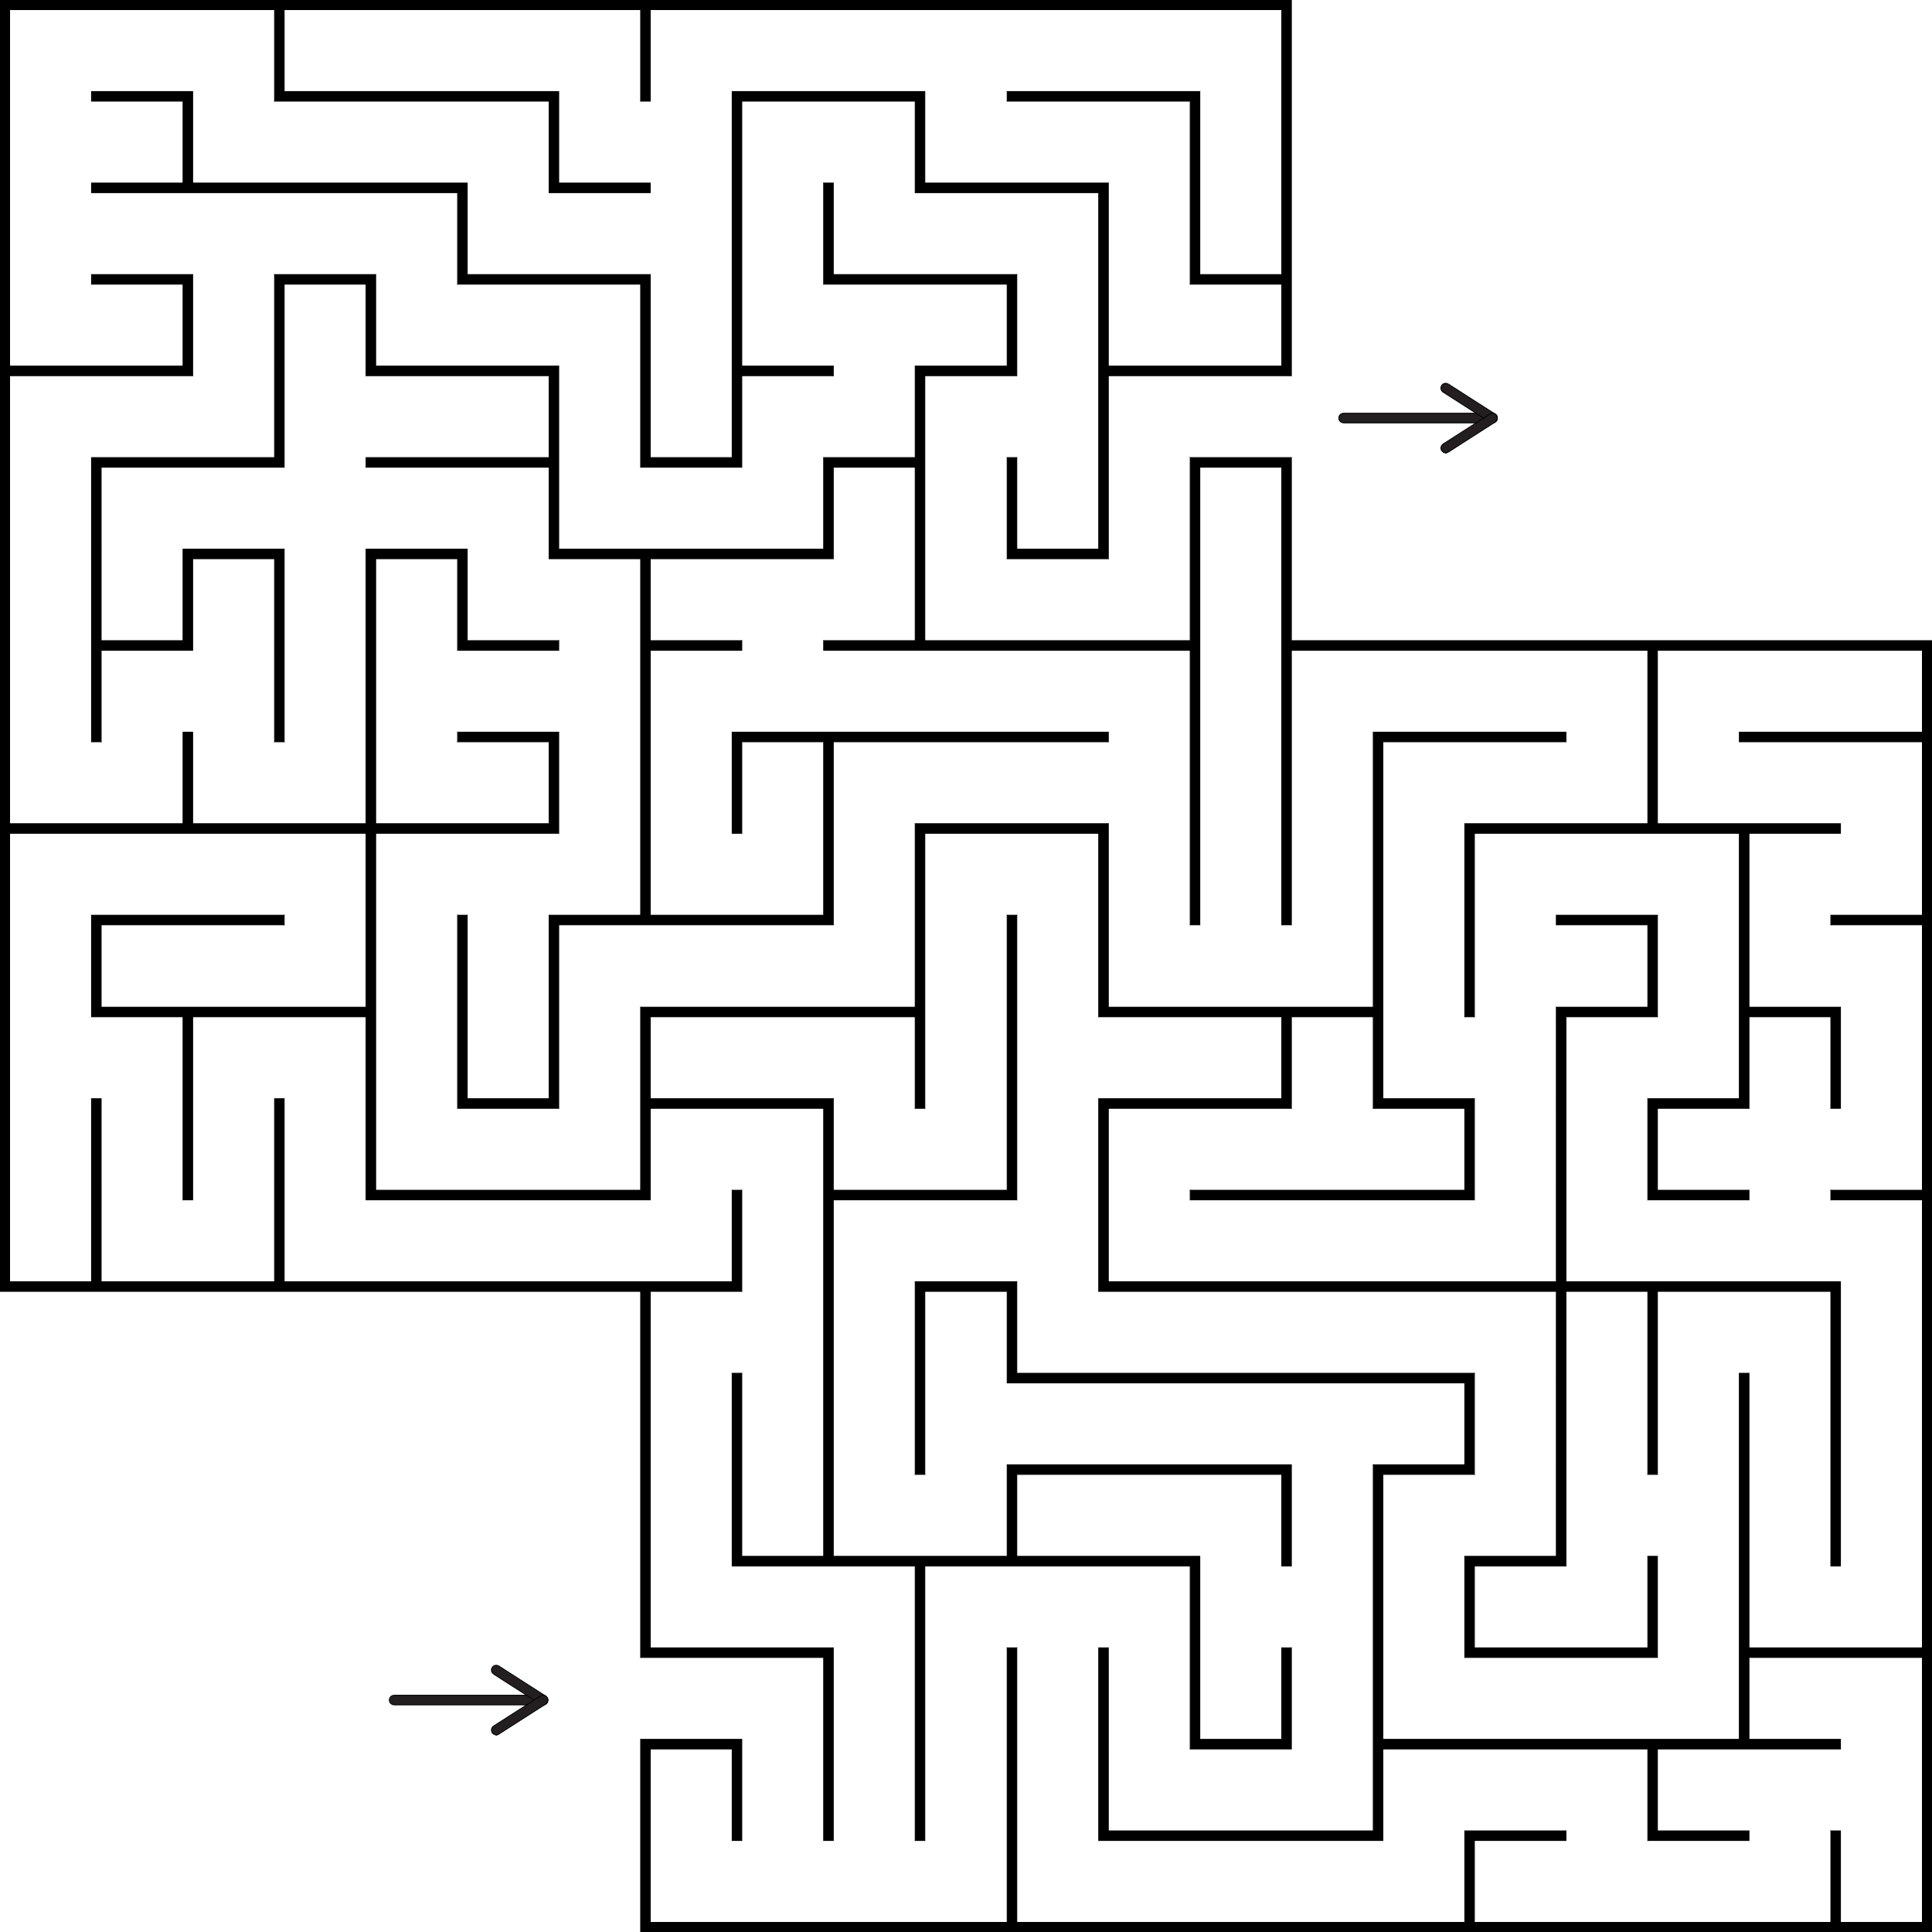
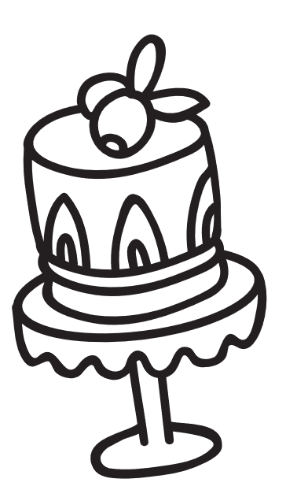
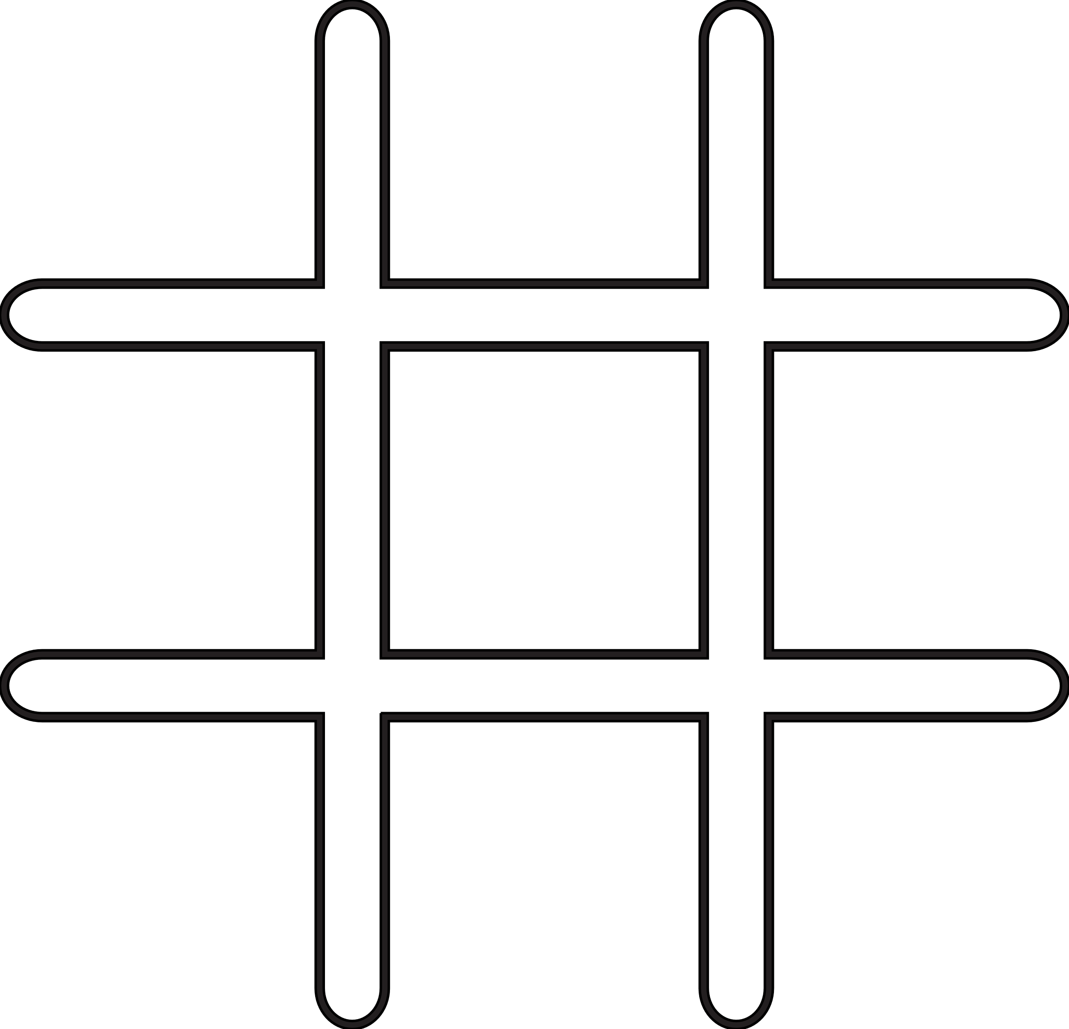
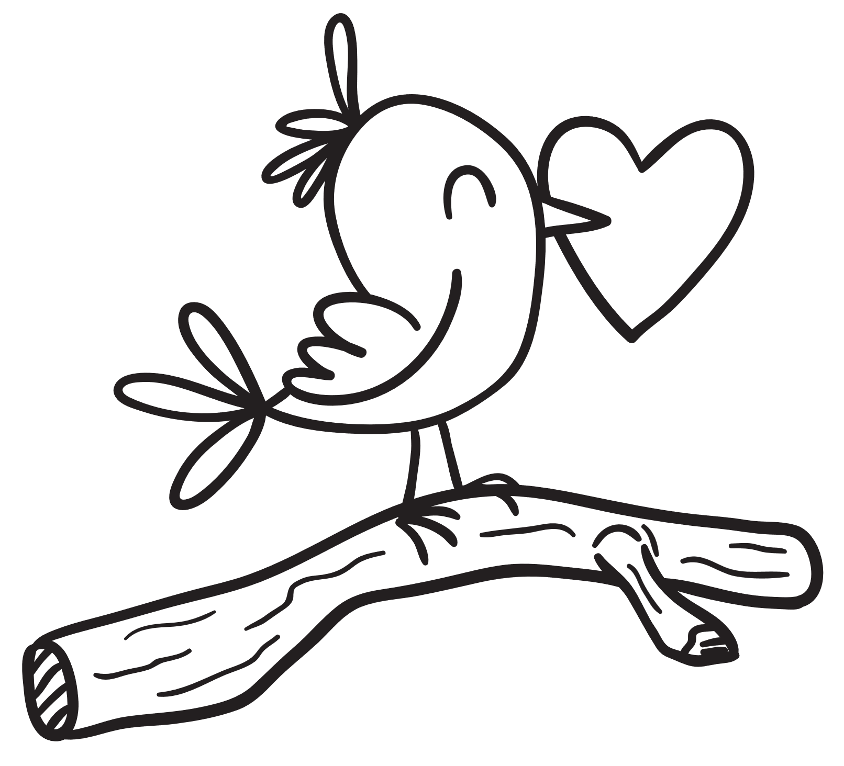
Word Search
Connect the Dots
Arrow
J
Rings
P
M
I
T
T
E
N
B
R
I
N
G
S
A
S
E
C
L
Chocolate
I
C
H
O
C
O
L
A
T
E
M
T
I
A
M
I
T
O
R
N
I
E
F
L
R
R
C
C
R
T
M
D
O
D
G
K
O
D
O
Draw
who’s calling
Mitten
G
S
N
S
S
W
G
F
Rose
E
O
T
C
H
O
Find all the flowers
Cards
Locks
Tic Tac Toe
Spot 6 Differences

Slide 2
Word Search
Connect the Dots
Arrow
J
Rings
P
M
I
T
T
E
N
B
R
I
N
G
S
A
S
E
C
L
Chocolate
I
C
H
O
C
O
L
A
T
E
M
T
I
A
M
I
T
O
R
N
I
E
F
L
R
R
C
C
R
T
M
D
O
D
G
K
O
D
O
Draw
who’s calling
Mitten
G
S
N
S
S
W
G
F
Rose
E
O
T
C
H
O
Find all the flowers
Cards
Locks
Tic Tac Toe
Spot 6 Differences

